Slide 1
Norwegian Association for Infection Prevention and Control 2024 - Annual Conference
Why is single use PPE still so prevalent?
Presented by:
Paul Chivers
Paul@PCCSustainableSolutions.com
Tel: +44 7771 922349
Norwegian Association for Infection Prevention and Control 2024 - Annual Conference 15th October 2024

Slide 2
Agenda
Introduction
What constitutes PPE in Health and Care settings
Analysis by product: issues, volumes, reusable options and benefits
Why does it matter?
What are the potential benefits?
What are the barriers?
Any questions
Norwegian Association for Infection Prevention and Control 2024 - Annual Conference 15th October 2024
Notes:
Gowns, Aprons, Masks, Respirators & filters. Considerations: Standards & testing, Laundry
Reuse – Laundry, behavioural change, routes to procurement, Tracking – RFID, QR, Barcode, manual

Slide 3
Introduction
22 years in the military
Created the first Health & Wellbeing Hub in the Sir Ludwig Guttmann centre
Head of PPE Reuse, Innovation and Sustainability – Department for Health and Social Care, and NHS Supply Chain
Independent Sustainability and Innovation consultant now working with:
  Mackwell Health Ltd – UV-C
  Hello Face – Transparent Medical Mask Reusable (TMMR) and Transparent P3
  Revolution-ZERO – Reusable gowns, aprons, TIIR, surgical drapes and laundry
  Bolle Safety – Eye protection, AGP protection and clip-in prescription lenses
  Envirosmart – Hypochlorous Disinfectant, microfibre single use and reusable
  RACLAC gloves – Compliant, 100% tested and untouched by hand, with innovative dispensing
Norwegian Association for Infection Prevention and Control 2024 - Annual Conference 15th October 2024

Slide 4
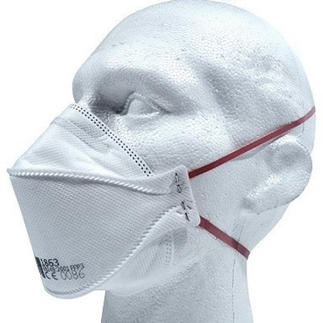
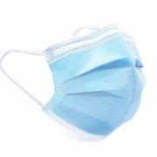

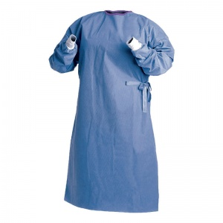

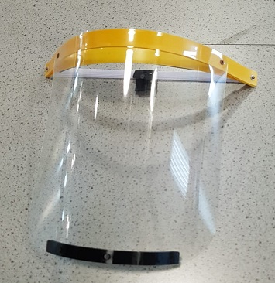
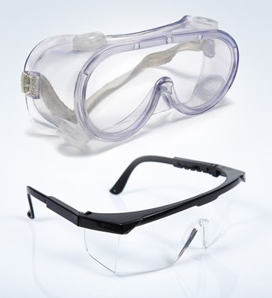
What constitutes single-use PPE?
Single use apron
Single use gown
TIIR; FFP3; Visor; Goggles & glasses; Gloves
Norwegian Association for Infection Prevention and Control 2024 - Annual Conference 15th October 2024

Slide 5

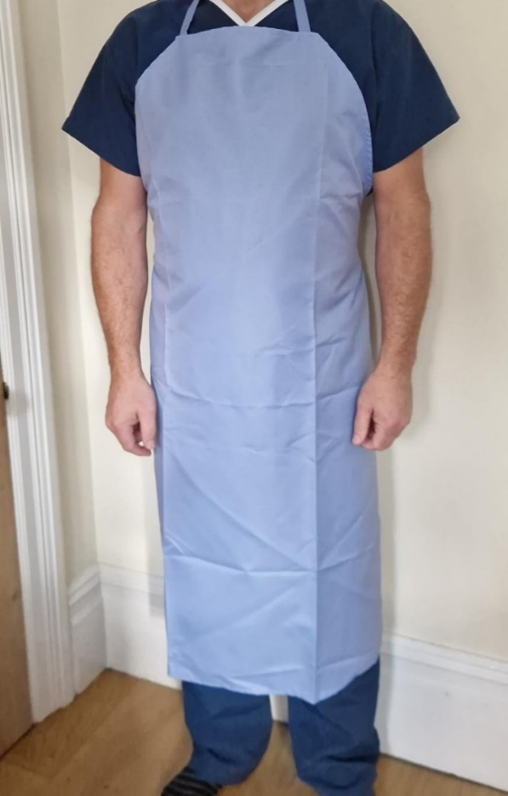
Aprons – BS EN7765-1:2004, BS EN6383-2:2004
Single-use issues:
Sizes
Tearing-off
Effectiveness
Annual volume circa 1.2bn, 664m
Waste
Reusable benefits:
Reduced waste & CO2(e)
Quality & fit improved
100 uses, circa 2,000 if wiped
Volume required circa 284,570
But – HTM01-04 laundry required
Single use
Reusable
Norwegian Association for Infection Prevention and Control 2024 - Annual Conference 15th October 2024

Slide 6
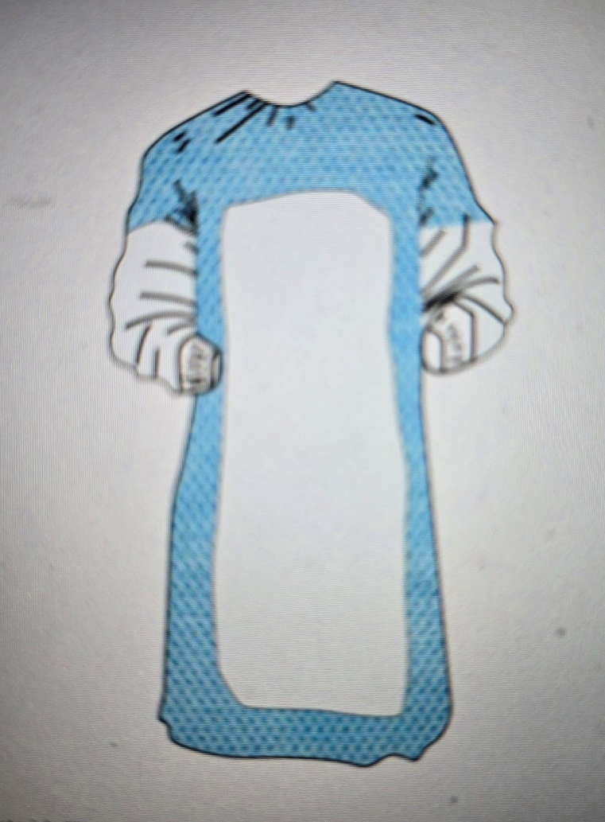
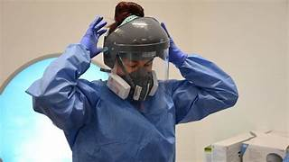
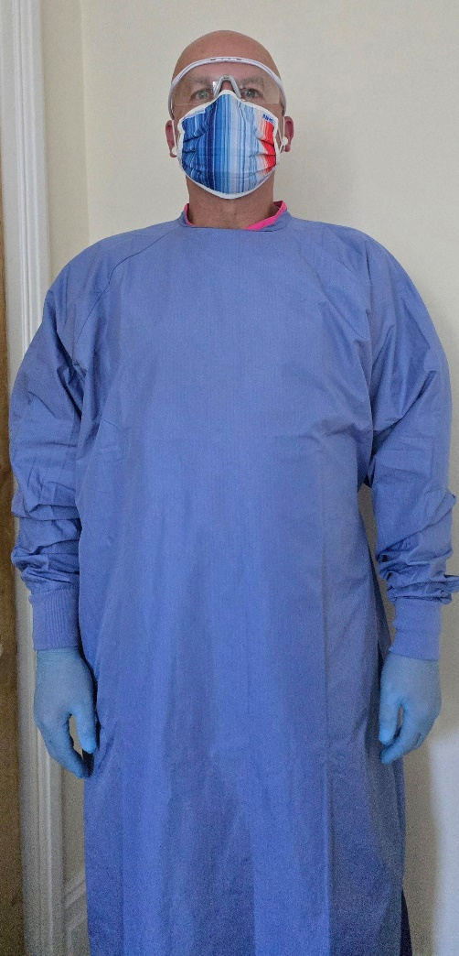
Gowns – EN13795:2019
Reusable benefits:
75 uses
Volume 83,200
Reduced waste
Quality and fit
RFID/tracibility
Used for endoscopy when end of impervious, sterile useful life
But – laundry & checks
Single-use issues:
Sizes
Heat
Volume 95m, 6.2m
Waste
Norwegian Association for Infection Prevention and Control 2024 - Annual Conference 15th October 2024

Slide 7

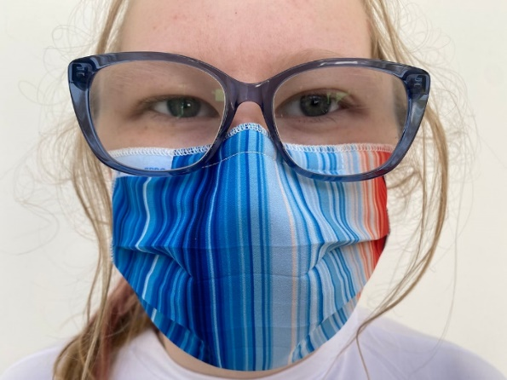
TIIR Mask – EN14683:2019
Single use findings
Reusable benefits:
Environmental benefits
Reduced plastic waste
Reduced CO2(e)
Reduced skin irritation
Fit on wearer improved
But – laundry & checks
Single use
Single use - additional issues:
Effectiveness when moist
Annual volume 1.2bn, 770m
Waste
Norwegian Association for Infection Prevention and Control 2024 - Annual Conference 15th October 2024

Slide 8
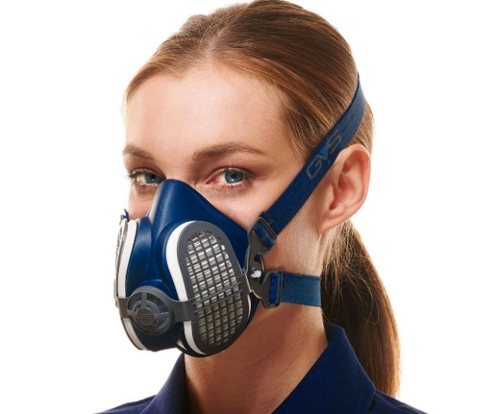
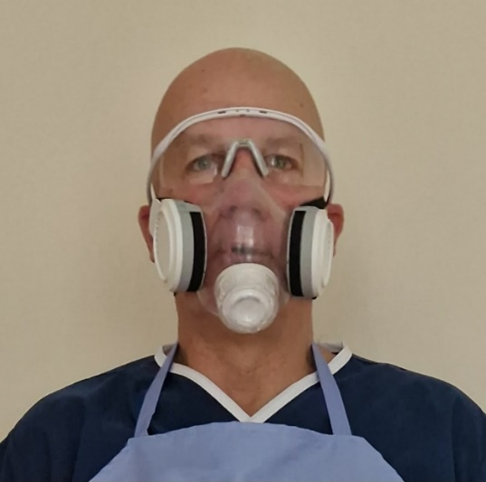
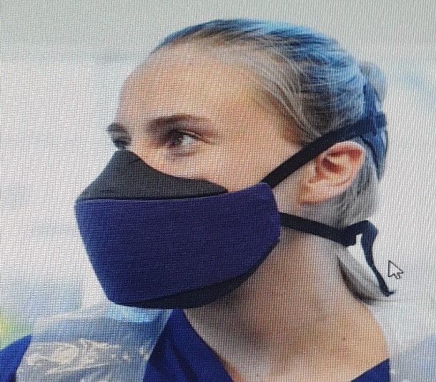
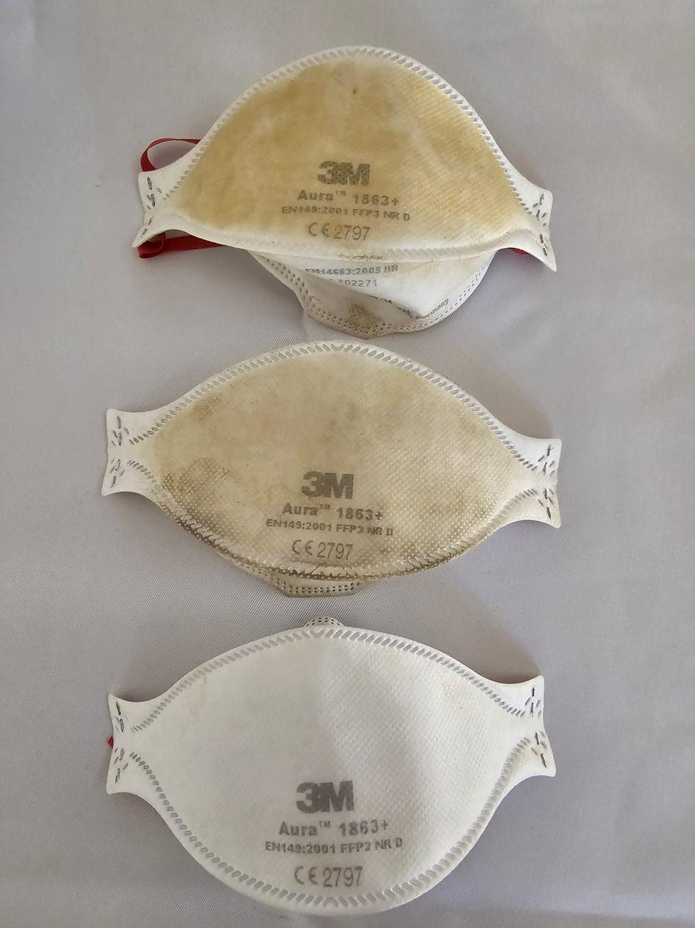
Respirators – EN149, EN140 & EN143, EN1827
Reusable in use
New Reusable and prototype for Health & Care
Single use – issues:
Size, fit & comfort
Fit test problems
Fogging glasses
Waste 77m, now 13m
New and prototype P3 benefits:
Improved fit test & comfort
100k required, lasts min 2 years
Reduced weight
But – no cleaning standards & HSG53
Single use
Norwegian Association for Infection Prevention and Control 2024 - Annual Conference 15th October 2024

Slide 9
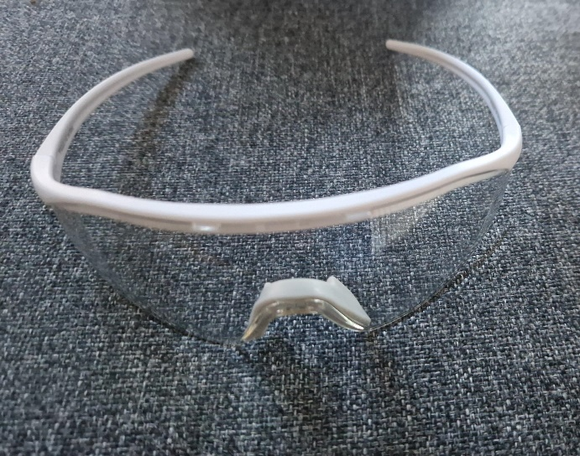

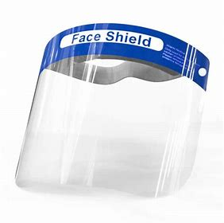
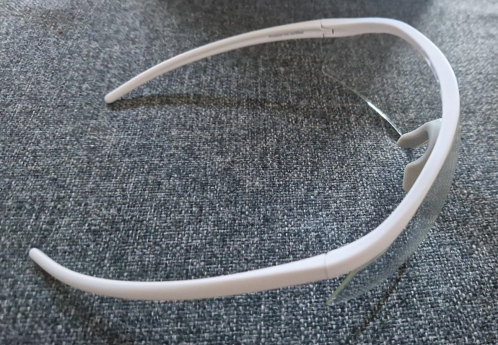

Eye Protection – EN166
Single-use issues:
Poor clarity of vision - needles looked bent
Possible injury to babies in maternity
Fogging
Didn’t fit with spectacles
Headaches
Waste
Annual volumes 110m, now 13.6m
Single use
Reusable
Reusable benefits:
Clarity of vision
Anti-fogging
Size, fit & comfort – OTG
Cost savings £600/2yr/user
Reduced waste
But – no cleaning
standards?
Norwegian Association for Infection Prevention and Control 2024 - Annual Conference 15th October 2024

Slide 10

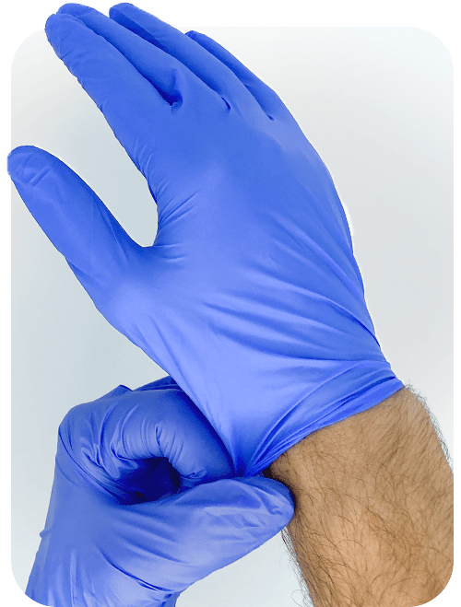
Gloves – EN420, EN455
The presence of pathogens and microbes responsible for FBI's (including E. coli and Staphylococcus), and those specific to food spoilage and occupational skin disease.
Findings are due to:
Poor sanitation of glove factories
The polluted water source used for glove manufacturing processes
The origins of these microbes and pathogens have been traced specifically to:
Polluted surface water from agricultural, industrial and urban run-off
Wastewater, human faeces and animal gut bacteria
Factory water filtration units
Glove drying cycles
Human skin bacteria
Paperboard packaging
On or near shore options
Volume reduced by 1.8Bn with training
47k Tonnes reduction CO2(e)
8k Tonnes reduction in waste
Reduced risk of supply chain issues
Reduced risk of HAIs
But – higher prices
Glove concerns
Volume 18.5Bn now 6Bn
£120m spend
Waste
CO2(e) impacts
Possible infections
Source: Eagle – “How clean are your disposable gloves?” Jul 2022
Norwegian Association for Infection Prevention and Control 2024 - Annual Conference 15th October 2024

Slide 11
Why does it matter?
Single use to reusable PPE plus reduction of inappropriate glove usage
Norwegian Association for Infection Prevention and Control 2024 - Annual Conference 15th October 2024
Notes:
Glove reduction is 15,109 pallets, which is £3.9m saving per year
581 vehicles with 26 pallets on a lorry @ £700/vehicle is £406k per year
Gloves 26
TIIR 10
Aprons 41
Visors/EP 231
P3
Gowns

Slide 12
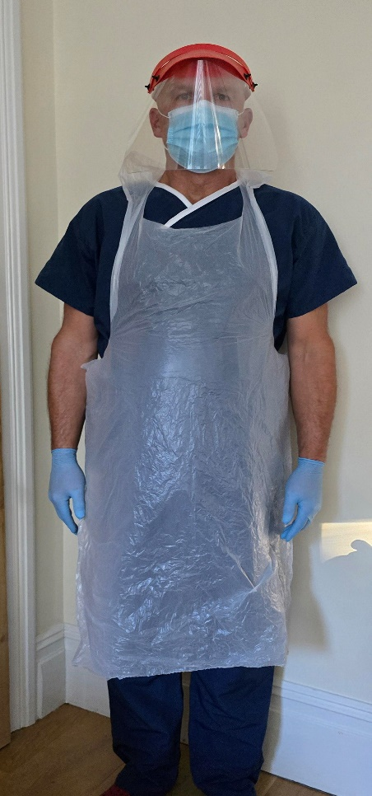
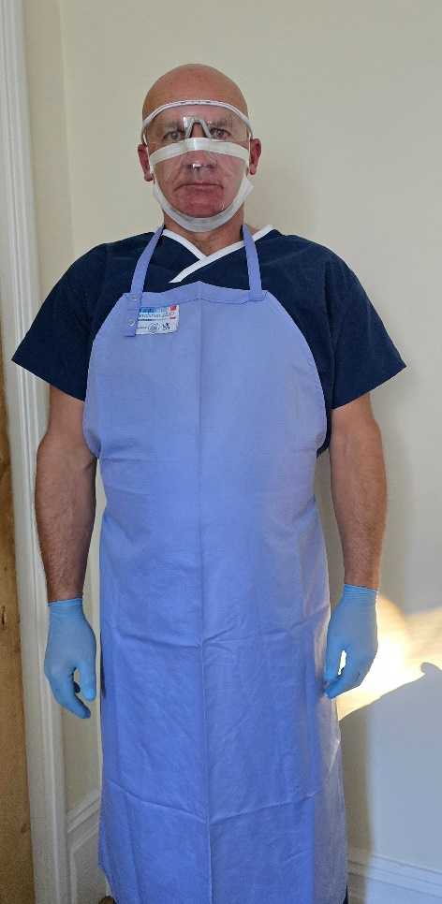


Potential benefits of reusable PPE
Environmental – 440T waste produced daily in NHS
Financial savings
Preparedness for future pandemics
7bn down to 4.2bn products – huge savings warehousing & logistics
Safety of users
Patient confidence
Reduction of warehousing, logistics
Professional image
Local employment
Norwegian Association for Infection Prevention and Control 2024 - Annual Conference 15th October 2024

Slide 13
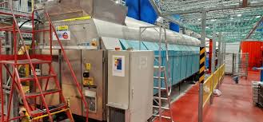
What are the barriers to reusable PPE?
Risk
Procurement – routes to market
Infrastructure to safely manage sustainable products (RFID, compliant laundries, agreed decontamination suite)
Testing, pre-pilot Regulatory checks, trials, pilots and reports
Cost, capacity and capability
Funding
Specific Health and Care standards for PPE
Immature products and processes
Education, training and behavioural changes
Norwegian Association for Infection Prevention and Control 2024 - Annual Conference 15th October 2024
Notes:
1 Defra – may ban wet wipes containing plastics, as they did with straws, microbeads and plastic stirrers as well as bag tax
Look at sprays and launderable cloths or paper towels, not white ones as they may need to be bleached
2 Support from wider community for healthcare specifications and standards. Remove the ambiguity
Is it PPE or MD? FFP3 or P3 or PAPR with exhalation valve should be avoided where possible – nothing in the standards under EN149, EN140/143. Nothing in about how clean it should be internally and externally for use in health and care settings. Manufacturers want to know what the challenge is!
3There is the SPOC for alerts etc, but community of pilots, trials, testing, development etc. Avoid replication, waste and coordinated approach make quicker and larger improvements
4 Difficult to gather meaningful dialogue, hence the need to encourage staff to come and engage, explain 1st hand the issues to suppliers, manufacturers to move to next gen PPE
5 Funding is key to improvement, I have a very limited budget and more is needed for step change, which will fund itself, but where do I go? Was DHSC, (Covid money), Then NHS Greener, now SCCL
6 Perhaps a community of decontam, IPC, CPS, Industry to work on processes and products
7 AHSNs, R&D, Innovation Team & members from Towers, RCN, IPC to work and engage collaboratively and more widely

Slide 14
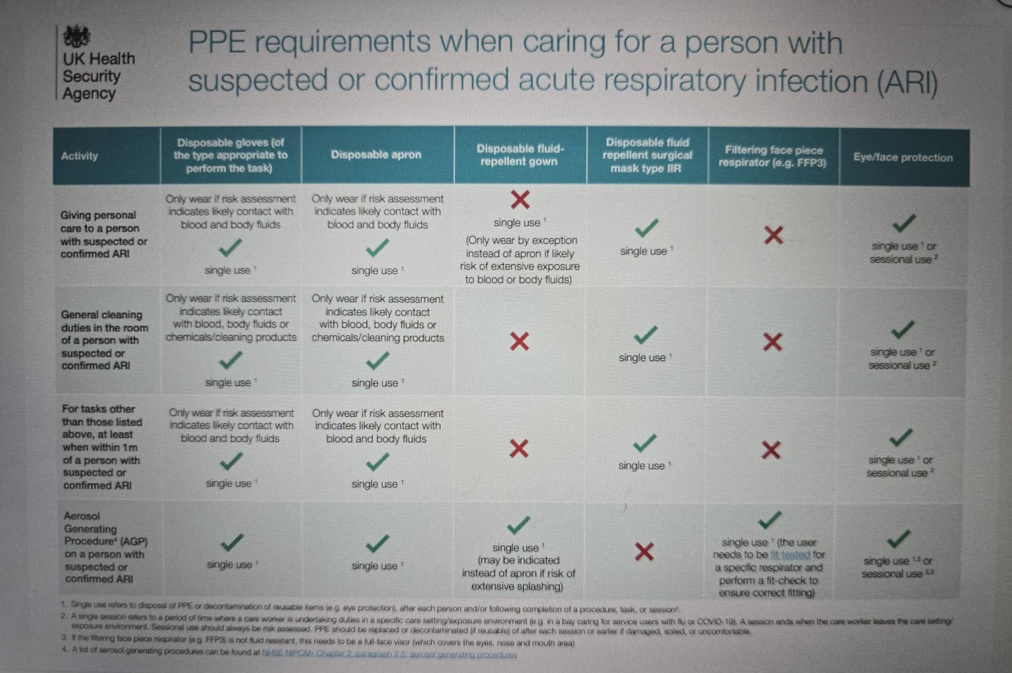
More barriers to reusable PPE?
FFP3 resilience principles in acute settings
A core priority for both NHS trusts and the DHSC is to ensure FFP3 resilience at both the national and organisation level for any future new variant of concern, or another respiratory virus that may lead to an epidemic or a pandemic.’
To support this requirement, guidance notes in the form of FFP3 resilience principles have been developed by the Department of Health and Social Care for acute clinical settings where FFP3s are used.
All FFP3 users should be fit tested and using at least two different masks
UK Make masks will be used for all new Fit Tests (high supply resiliency and excellent fit test performance) when appropriate for the individual
Fit testing will be repeated at least every two years
Norwegian Association for Infection Prevention and Control 2024 - Annual Conference 15th October 2024

Slide 15



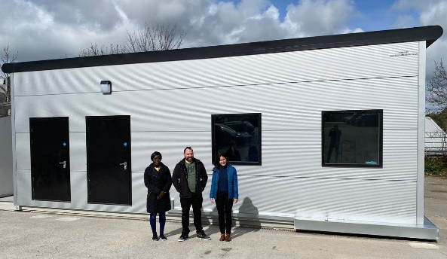
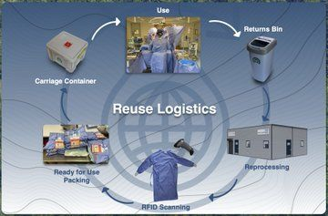
Solutions to the barriers to reusable PPE?
P3 Respirators and Eye Protection:
Use the same process to clean and decontaminate P3 respirators
Accepting wet wipe usage or diluted bleach
Reprocessing air cushioned anaesthetic masks - Uses Hypochlorous Disinfectant with microfibre, then BS8628-2022 certified UV-C cabinets from Mackwell Health Ltd for High Level Disinfection (HLD).
Move from single use to 50 – 100 reusable uses
Reduce waste by 160T and CO2(e) by 900T annually.
Norwegian Association for Infection Prevention and Control 2024 - Annual Conference 15th October 2024

Slide 16
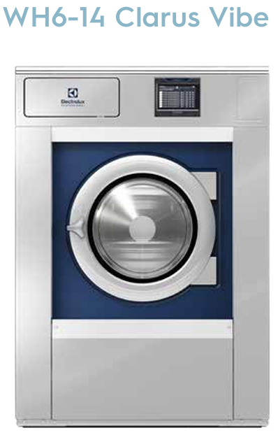

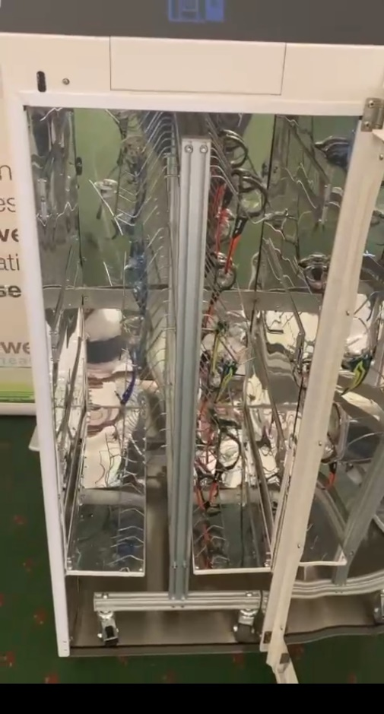


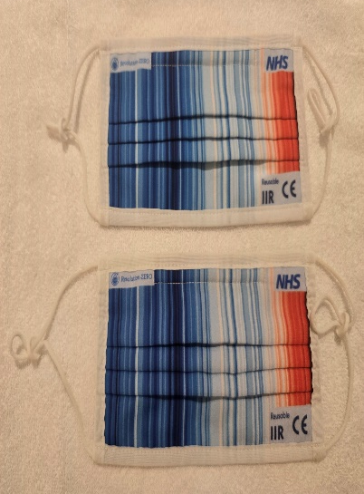
Solutions to the barriers to reusable PPE?
P3 Respirators and Eye Protection:
Use the same process to clean and decontaminate as anaesthetic masks
Compliant laundry
Tallbox and Minibox reprocessing Eye Protection
Norwegian Association for Infection Prevention and Control 2024 - Annual Conference 15th October 2024

Slide 17
What are the barriers to reusable?
Behaviour Change
Standards
Tracking
Procurement
  Trial/pilot
  Tender or framework
Cleaning/decontamination
  Robust product or specialist process
End of life

Slide 18
Summary
Poor quality products, not popular with users – reusable addresses these
Environmental damage – reusable significantly reduces these
Waste production – reusables have many more uses per product
Pandemic preparedness addressed
Overspend on products, warehousing, logistics and waste management
Infrastructure requirements manual then technology when scaling
Standards for Health & Care settings
Testing, trials and evidence for change
Behavioural changes, education training and risk mitigation
Procurement, lack of on or near shore production
LCA including End of life processes
Norwegian Association for Infection Prevention and Control 2024 - Annual Conference 15th October 2024

Slide 19
Summary of user surveys
Norwegian Association for Infection Prevention and Control 2024 - Annual Conference 15th October 2024

Slide 20
Summary of user surveys continued
Norwegian Association for Infection Prevention and Control 2024 - Annual Conference 15th October 2024

Slide 21
Any Questions?
Paul Chivers
Paul@PCCSustainableSolutions.com
Tel: +44 7771 922349
X (formerly Twitter) - @paulchivers19
LinkedIn - https://www.linkedin.com/in/paul-chivers686

